Slide 1

Automate Multi-Turn
Agentforce
Testing
Building Trust with Agent Harness through
Scalable, Reliable Testing
17th September, 2026

Slide 3
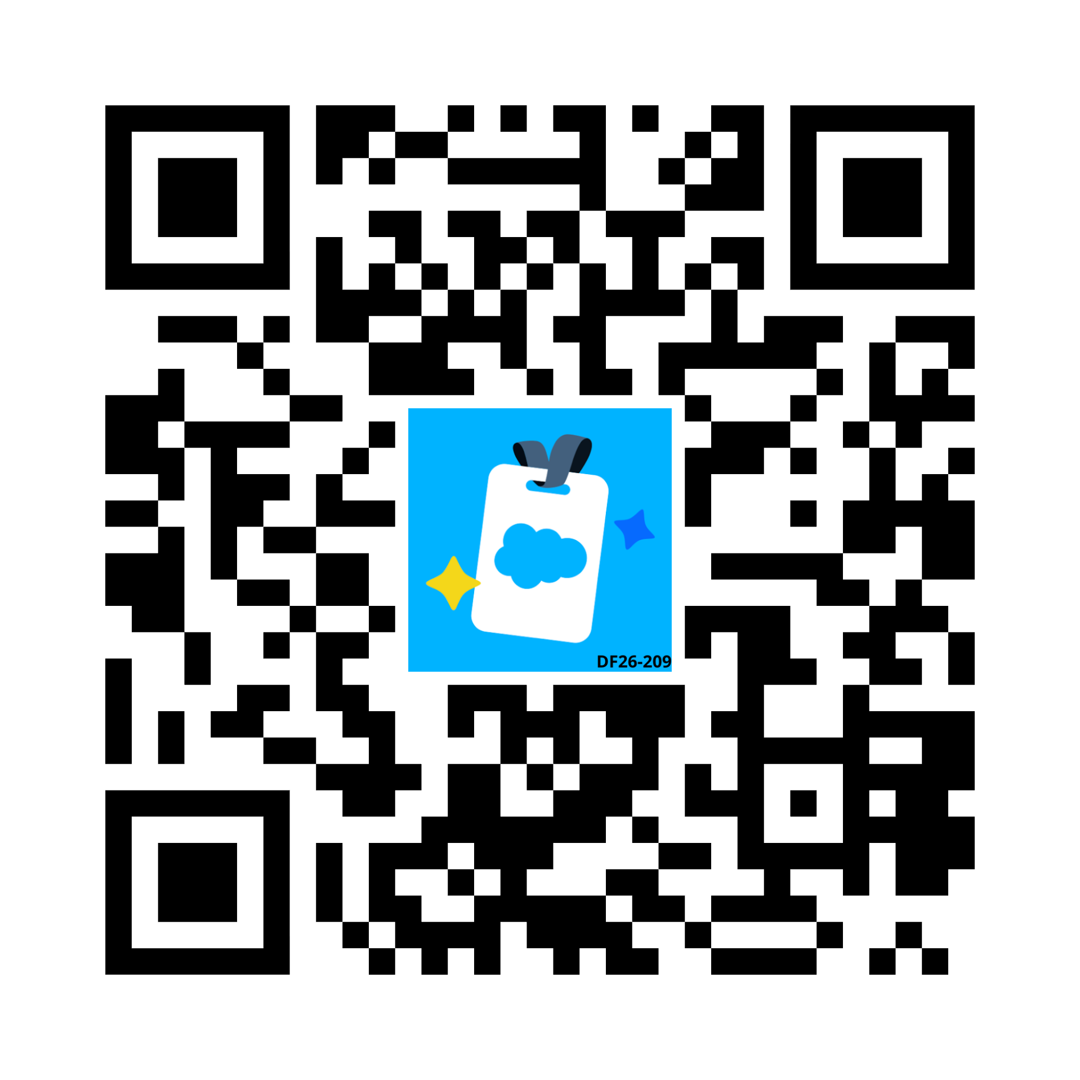
Coffee on us.
The first 4,000 attendees to provide feedback on this event will receive a $5 Starbucks gift card.*
1. Download the Salesforce Events mobile app.
2. Navigate to My Event, then My Surveys.
3. Complete (4) session surveys and the Event Survey.
4. Redeem your gift at Badge Pickup on September 17th.
*Restrictions apply. See terms and conditions at sforce.co/survey-terms

Slide 4

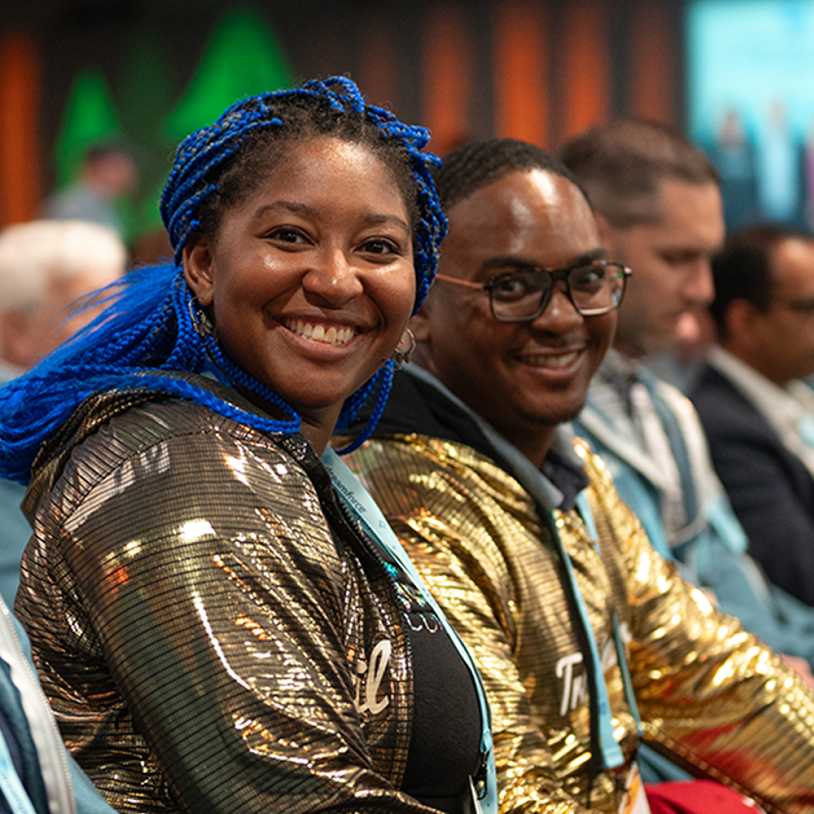

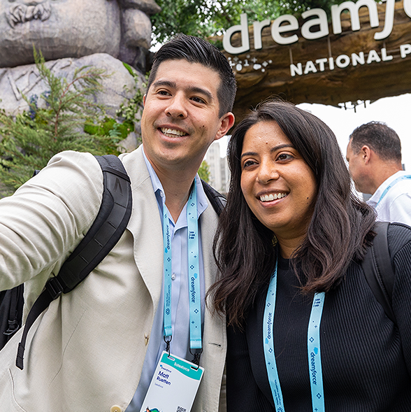
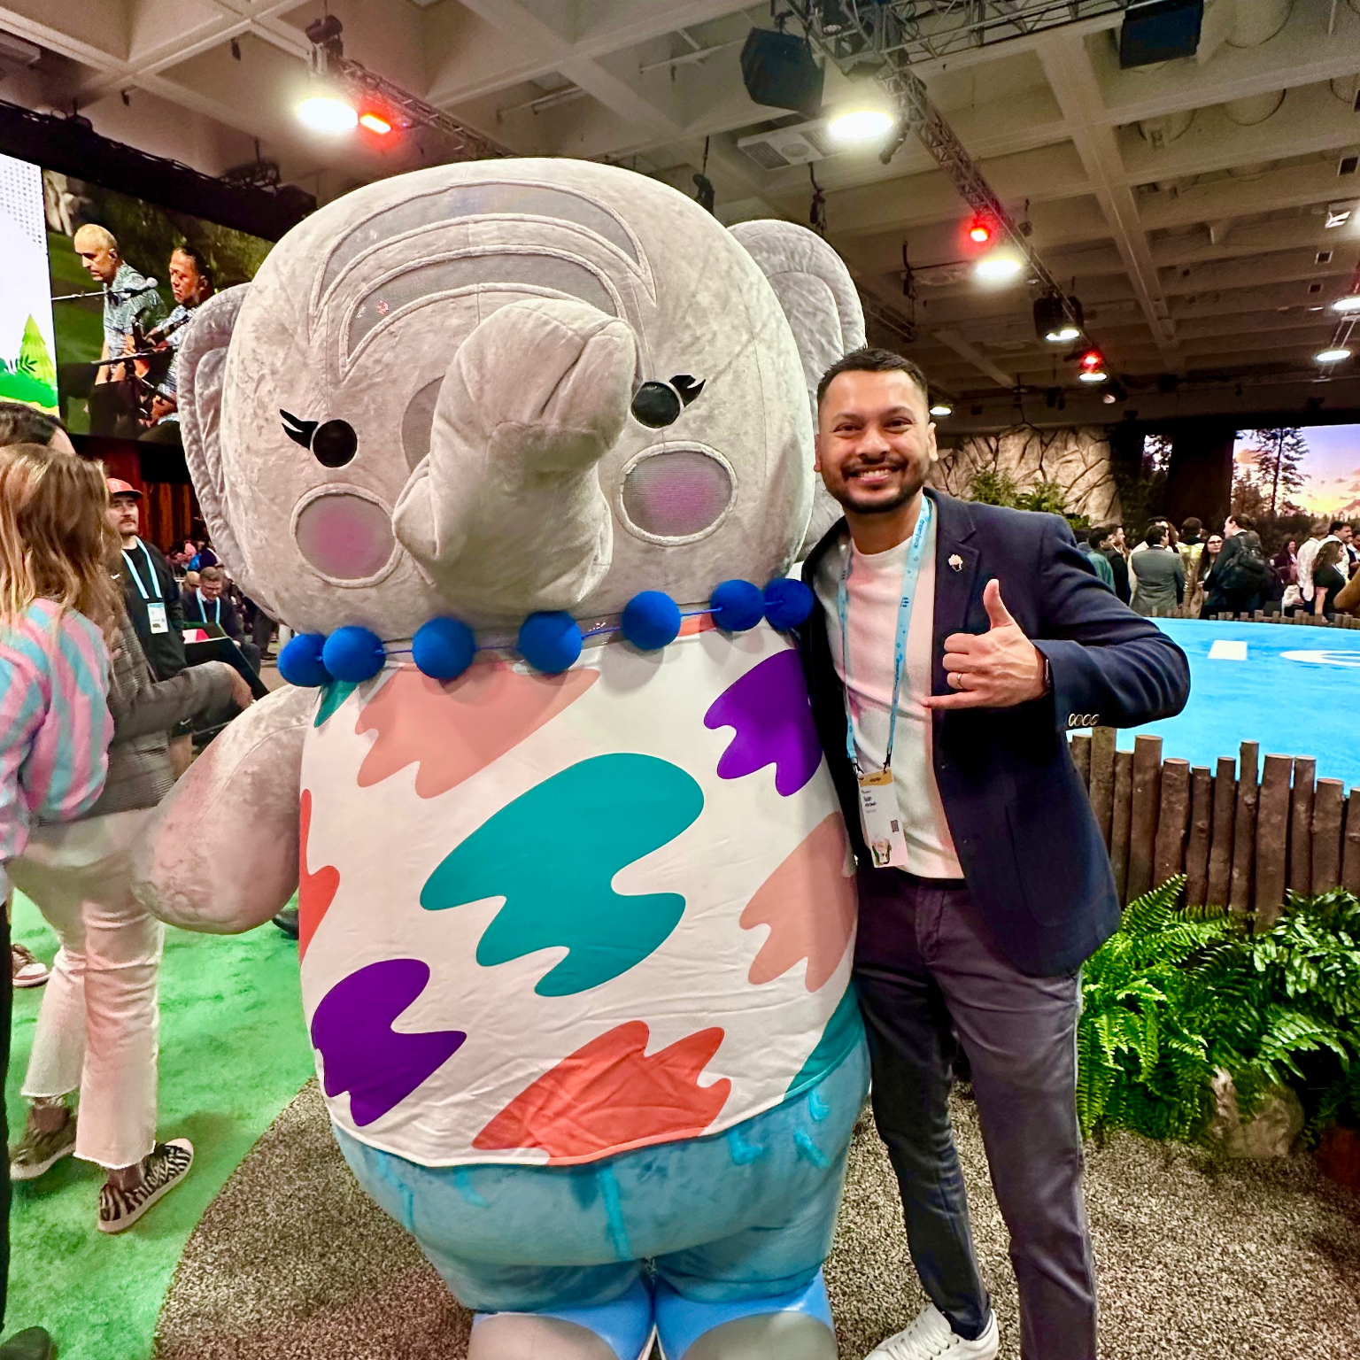
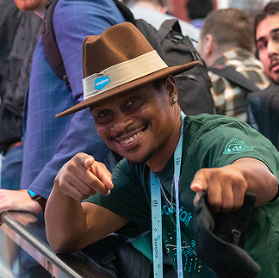

Slide 5


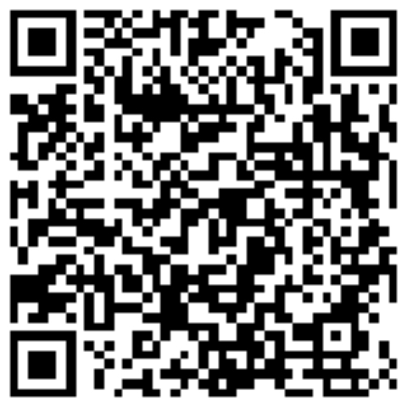
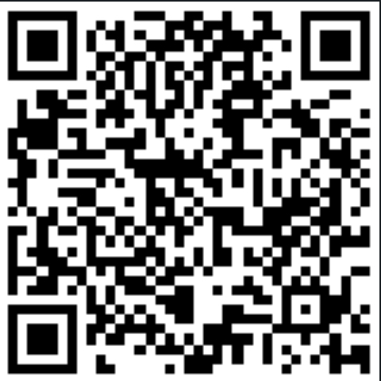
Tuan Abdeen, CTA
Slaviša Maslić, CTA
Senior, Forward Deployed Engineer Salesforce, UAE
Deployment Strategist Director Salesforce, Switzerland

Slide 6

Trust is the
Foundation of Agentic Success
Notes:
Trust is the foundation of Agentic Success
Every Agentforce customer we meet asks the same question:
‘How do I trust this in production?’
And that’s why trust has become the foundation of agentic success.
If you don't trust it, it will not scale.
It is as simple as that.

Slide 7



Why Testing Matters
Why testing is the foundational
Risk Mitigation
Market Velocity
Cost Efficiency
Detecting critical vulnerabilities before they reach production protects brand reputation and avoids catastrophic system failures.
Consistent testing allows for faster release cycles. Quality is the engine that drives speed.
Fixing a bug in development is X-times cheaper than fixing it after launch. Early detection is pure business profit.
Testing is no longer a final step — it is the engine of enterprise adoption.
Notes:
Why Testing Matters
For many of us, testing has often been treated as an afterthought - let’s build it first and test it later.
But there are many reasons why testing is foundational to a successful delivery.
We all know it.
So the question is: why is testing especially important for AI agents?

Slide 8
Why Testing Matters in Agentic AI
When agents are customer-facing, every response shapes brand trust.
Customer-Facing Risk
THE STAKES
Agents act on behalf of the brand — every turn is a brand moment.
One inconsistent
response can
erode years of
customer trust.
Regulatory Exposure
Inconsistent answers create compliance and legal risk.
Adoption Velocity
Trust gaps stall expansion across business units and markets.
Operational Cost
Late-stage defects are exponentially more expensive.
Agent Reliability isn’t optional – it’s a must!
Notes:
Why Testing matters in Agentic AI
Explain Multi-Turn
Let me put this in business terms.
When an AI agent is customer-facing — whether it's answering questions, processing requests, or making recommendations — every single turn is a brand moment.
One inconsistent or incorrect answer can erode years of customer trust.
And in regulated industries, it can create real compliance and legal exposure.
Therefore, Reliability is the new differentiator in the agentic era.
Which leads us to a hard truth — why the traditional testing doesn’t actually work for agents.

Slide 9
Traditional Testing Doesn't Work
for Non-Deterministic Agents
Design and Build
Testing
Deploy and Regression
TRADITIONAL SOFTWARE
AGENTIC AI
Deterministic
20%
50%
Non-Deterministic
5%
5%
Same input → same output
5%
Same input → variable outputs
5%
5%
Test once, trust forever
5%
20%
Behavior drifts as models evolve
5%
5%
End-of-cycle validation works
5%
Late testing = late surprises
5%
30%
10%
Stable regression baselines
20%
Requires continuous validation
We need a new testing paradigm — built for agents, not for code.
Notes:
Traditional Testing don’t work for Non-Deterministic Agents
Traditional software is deterministic. The same input produces the same output.
Test once, you can trust forever.
Therefore, End-of-cycle validation is fine.
Agentic AI is fundamentally different. It is non-deterministic.
Because of its generative nature, the same input can produce variable outputs.
Therefore, late testing becomes late surprises.
We need continuous validation, not point-in-time validation.
I like to call it the Micro-Agile Testing approach.

Slide 10
The Agentic Testing Maturity Journey
From manual validation to continuous, automated regression.
WHERE MOST TEAMS START
SCALING VALIDATION
ENTERPRISE-READY
Manual Testing
Batch Testing
Automated Continuous Testing
Conversations tested by hand
Static or fabricated data
Validated in Agent Builder Preview
Predefined CSV test scripts
Scenarios run via Testing Center
Improved repeatability and coverage
Fully automated regression
Continuous behavior validation at scale
Early drift and quality detection
Past: Reactive
Transition: Foundational
Present: Scaling
100% Manual execution, fragmented tools, and high defect leakage into production.
Core test automation setup and framework design with Testing Center
Regression suite stabilization, Automated and Continuous Testing Suite
Notes:
Agentic Multi-turn Testing Maturity Journey -
This is the 3-Phase Agentic testing maturity journey we encourage all of our customers to follow.
Agentic Use cases are frequently of multi-turn scenarios. Agents are conversational solution
Stage 1 — Manual Testing.
This is where most teams start.
Conversations are tested manually in Agent Builder Preview, using static or fabricated data.
100% manual execution.
It works for a single agent. But, it becomes difficult to scale.
Stage 2 — Batch Testing.
Predefined CSV scripts, scenarios run through Testing Center.
You get repeatability and coverage. This is the foundational layer to transition into an enterprise-grade automation.
Stage 3 — Automated Continuous Testing.
Fully automated regression for Continuous behaviour validation.

Slide 11
Real-world
Customer Impact
How we approached Testing at Scale
to create a meaningful customer impact
Notes:
Real-world Customer impact
Let’s shift gears now.
Let me walk you through a recent customer engagement, which we both part of as a FDE Pod/Team and how we approached testing at scale
To create a meaningful customer impact.

Slide 12
Customer Context
Re-engaging dormant leads at scale - email-only, 3 touchpoints, human handoff on intent.
NARRATIVE
BUSINESS OBJECTIVE
Sales team lacks capacity to work on 800K/year inbound leads
Qualified prospects were going dormant.
Agentforce Lead Nurturing Agent owns the unattended prospects: nurture, qualify, hand off.
Email-only channel
Increase qualified meeting bookings from previously unattended lead segments - without adding additional headcount.
JOBS TO BE DONE:
Draft and send a personalised, introductory email.
Up to 3 tailored follow-ups at
Scheduled intervals
Intent to meet or hear more
Opt-out / Unsubscribe / Not-Interested;
1. Initial Outreach
2. Follow-up Nudges
3. Positive Responses
4. Negative Responses
Notes:
Customer Context
Here’s the Customer Context, in a nutshell.
The customer’s sales team was generating nearly 800,000 inbound leads annually, but the sales team simply didn’t have the capacity to engage every prospect.
As a result, many qualified prospects were going dormant.
For this, they implemented an Agentforce Lead Nurturing Agent (formerly known as the SDR Agent) to engage unattended prospects, through the email channel.
The business objective was clear — increase qualified meeting bookings from previously unattended leads, without adding additional headcount.
And the agent had 4 jobs to be done — initial outreach, follow-up nudges, a positive-response and negative response handoff.

Slide 13

See them in Action
3-Layers of Multi-Turn Testing
Build Trust with Testing: to scale agents in Prod
01 Manual Testing
02 Batch Testing
03 Automated Testing
Agent Builder Preview
Pre-defined CSV + Testing Center
Python Script + YAML Test Suites + Testing Center

Slide 14
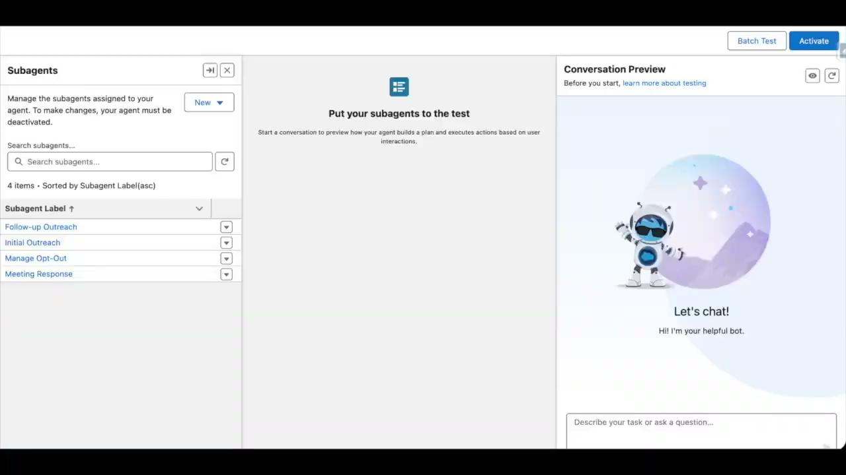
01 Manual Testing with Agent Builder Preview

Slide 15
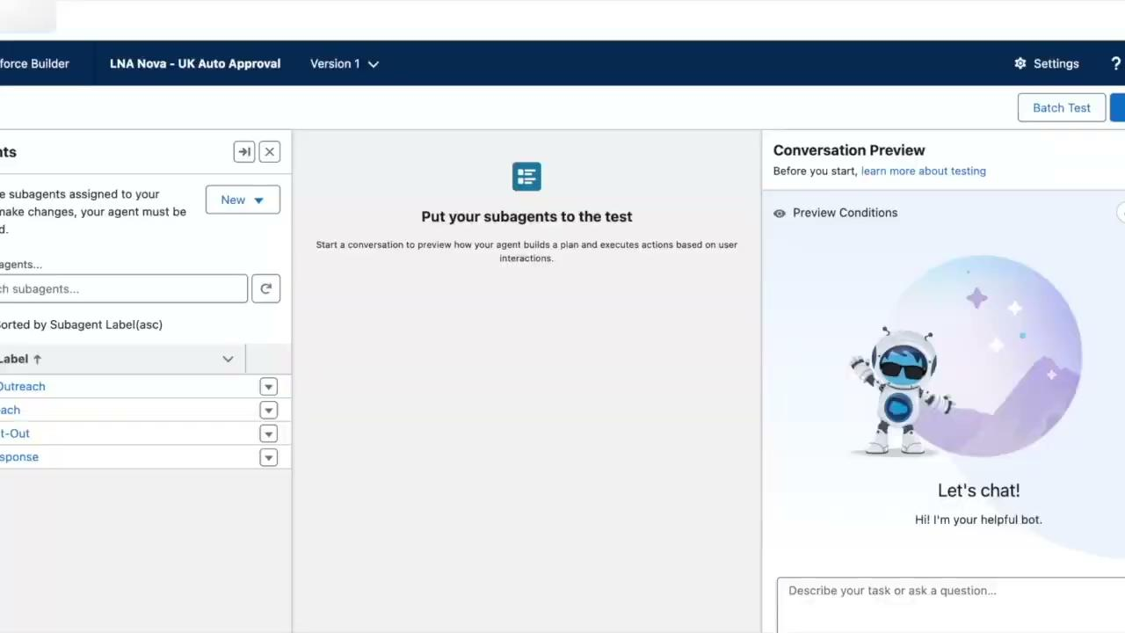
02 Batch Testing with Testing Center

Slide 16
03 Automated, Multi-Turn Agentforce Testing
Helping to scale Agentforce Deployments with Confidence and Trust
1. Seed Data
Create ‘N’ test Leads in the org from a JSON-based Template;
(persist 15-char Salesforce Ids)
2. Generate
YAML test suites from a reusable template
(One Test Case per Lead, with dynamic Context - LeadId, Context Variables)
3. Deploy and Run
Agent DX: Sf agent test create, run, results
(On Agentforce Lead Nurturing Agent)
4. Report
Results Collected & Consolidated
(Write timestamped Markdown Report to evaluate final outcomes)
100% Automated
4
Test suites covered
6+
Personas tested in parallel
3
CLI flags for partial runs
100%
Outputs versioned by timestamp
From hours of manual UAT to a single command — every release, regression-tested.
python3 run-automated-tests.py --org <alias> [--skip-leads] [--step N]

Slide 17
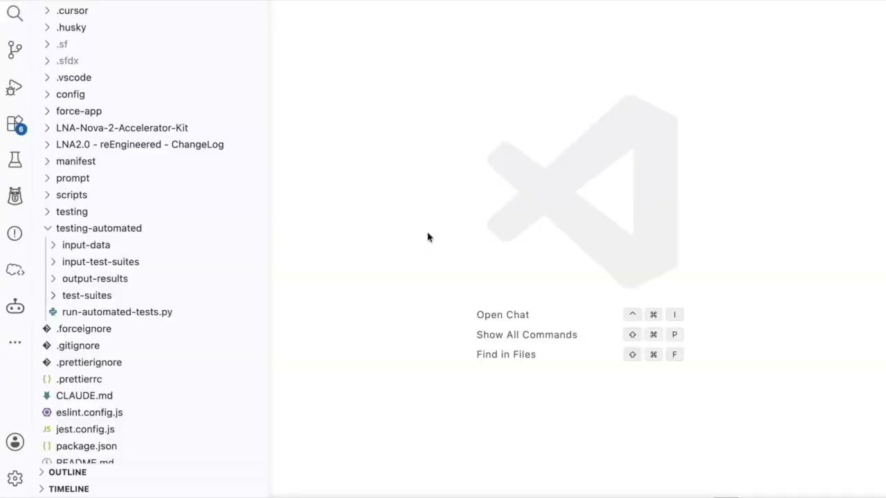


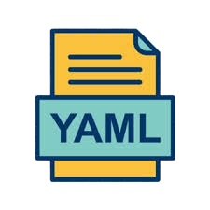
03 Automated, Multi-Turn Agentforce Testing

Slide 18


Customer Impact and Efficiency Gains
BEFORE FDE ENGAGEMENT
AFTER FDE ENGAGEMENT
1 agent live.
Adoption stalled.
3 agents in production.
Scaling fast.
Trust and reliability concerns
Trust restored. Adoption accelerated.
Insufficient testing practices
Expanding across additional agents, markets and industries.
Low ROI
Increased ROI
Manual (Before)
80 Hours / week
Automated (After)
4 Hours / week
95% efficiency gain in Regression Testing
Unlocked → From a single struggling agent to a scaling agentic platform.
Notes:
Customer Impact
Here is where we ended up.
Before our FDE engagement — one agent was live, but adoption was stalled.
They had Trust and reliability concerns due to lack of Insufficient testing practices.
After — 3 agents are now in production, scaling fast.
Trust restored. Adoption accelerated.
Expanding across additional agents, markets, and industries.
The regression testing went from 120 hours per week, to 12.
A ninety percent efficiency gain. [Pause.]
But honestly, the hours saved are not the real story.
The real story is about the agent roadmap.
From a single struggling agent — to a scaling agentic platform.
That is what we unlocked with the Automated Continuous Testing.

Slide 19
2 Key takeaways to take home today !
1
2
ONE
TWO
Agentic AI is non-deterministic → Testing has to be Continuous
Not End-of-Cycle
The Testing Maturity Journey is real.
Start Manual → Batch → Automate to Scale.

Slide 20
Notes:
Thank You for your time today
I want to remind you of 2 things to take with you today.
One — agentic AI is non-deterministic, so testing has to be continuous, not end-of-cycle.
Two — The maturity journey is real.
Start manual, move to batch, automate to scale.

Slide 21
Coffee on us.
The first 4,000 attendees to provide feedback on this event will receive a $5 Starbucks gift card.*
1. Download the Salesforce Events mobile app.
2. Navigate to My Event, then My Surveys.
3. Complete (4) session surveys and the Event Survey.
4. Redeem your gift at Badge Pickup on September 17th.
*Restrictions apply. See terms and conditions at sforce.co/survey-terms

Slide 22


Session summaries available soon
A short recap of this session is on
its way. You’ll find it later today in the Salesforce Events mobile app
or online on the sessions page.

Slide 23
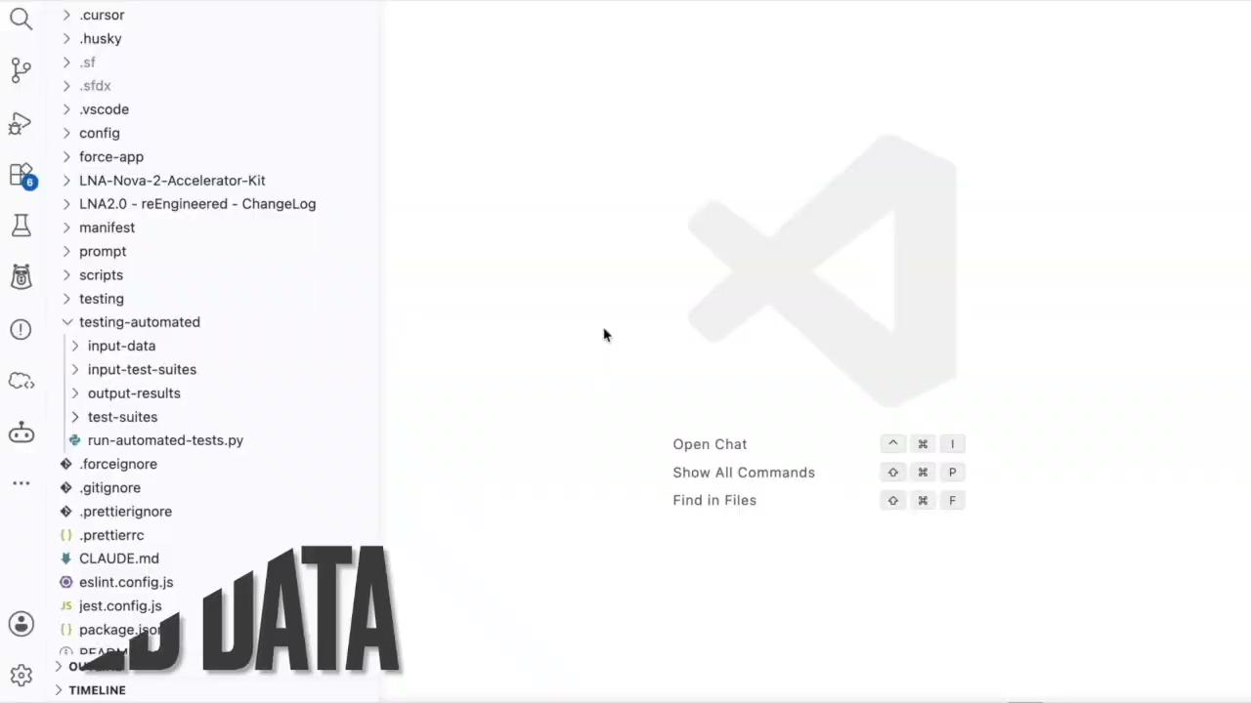
03 Automated, Multi-Turn Agentforce Testing

